Slide 1
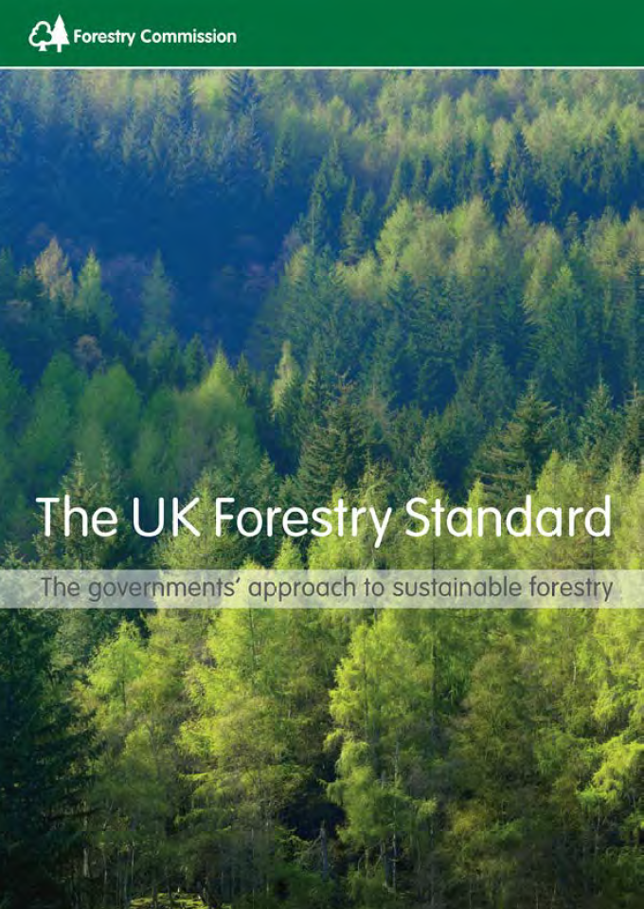
SRDP action to protect open ground habitat and species
Colin Edwards
Environment Policy Adviser
Scottish Forestry
Notes:
Colin Edwards – I am responsible for that part of Scottish Governments forestry approach that is covered in the Biodiversity section of the UKFS: covering interpretation, evidence gathering and research, strategic planning, regulation and compliance.

Slide 2
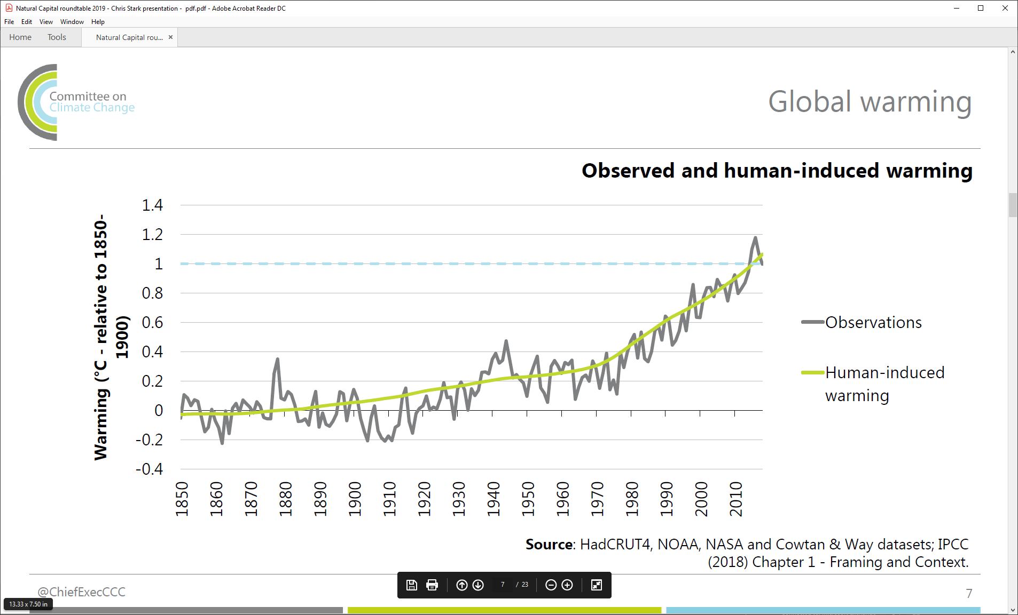
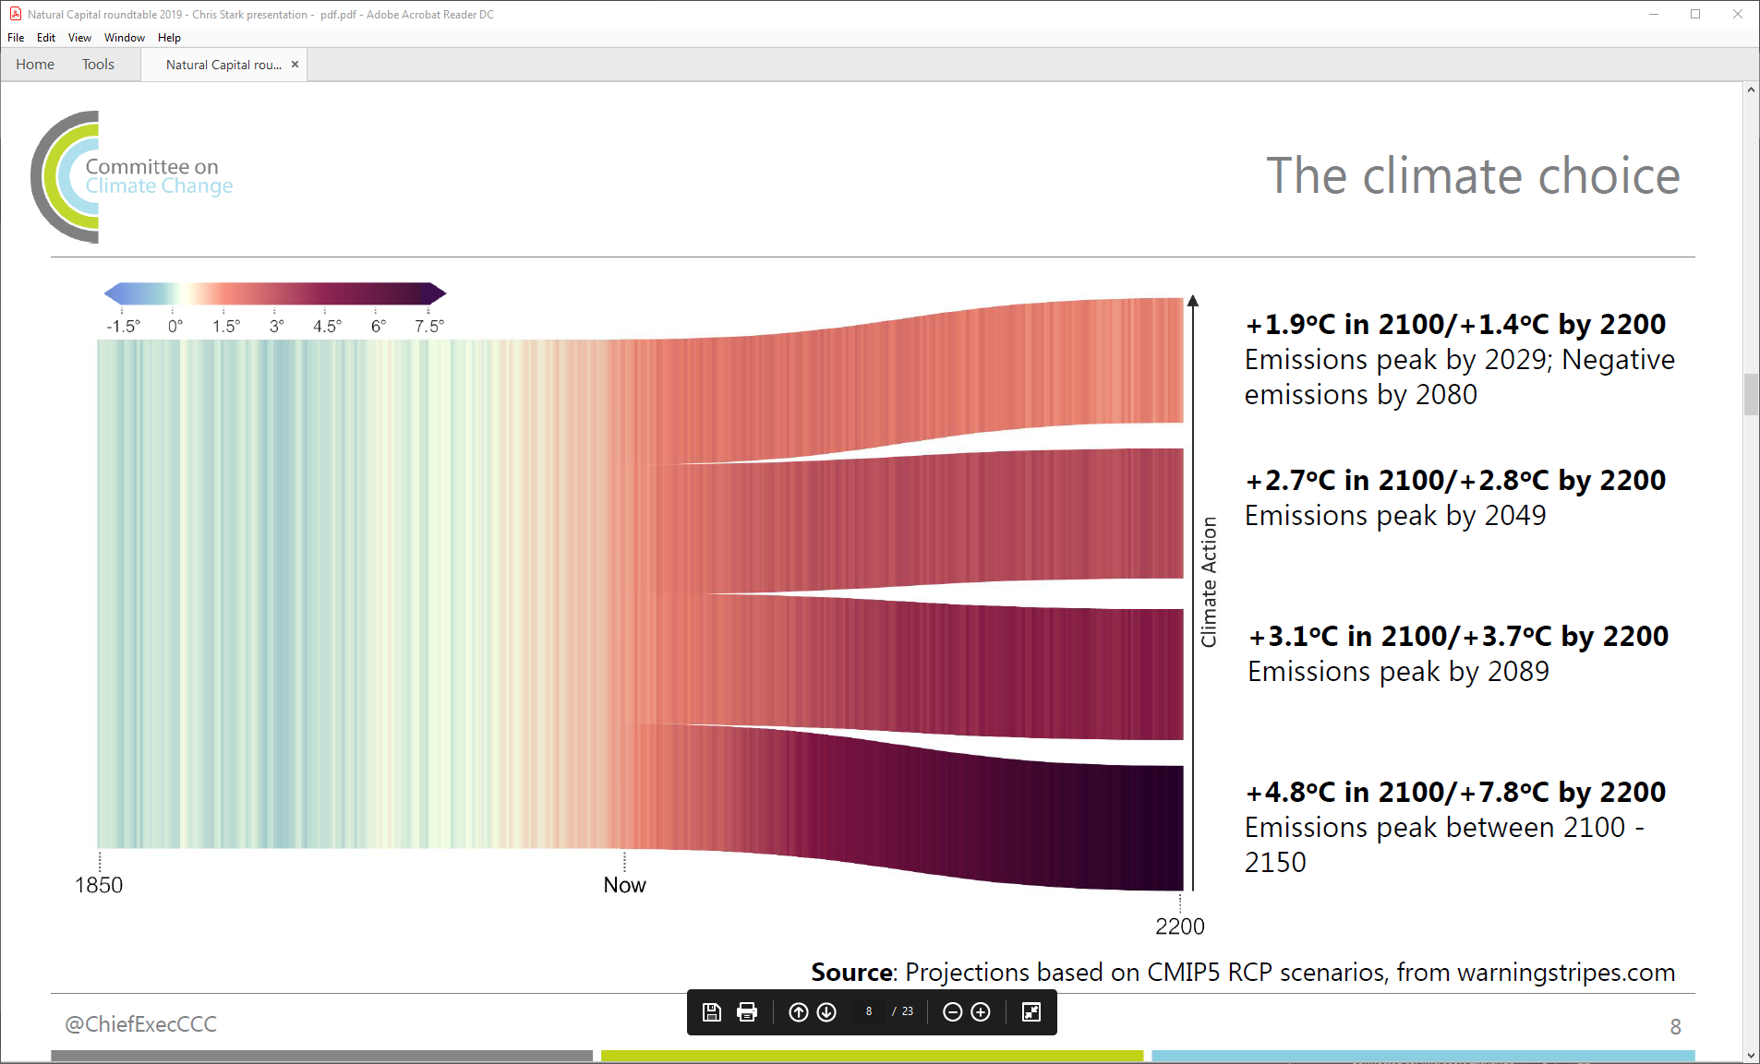
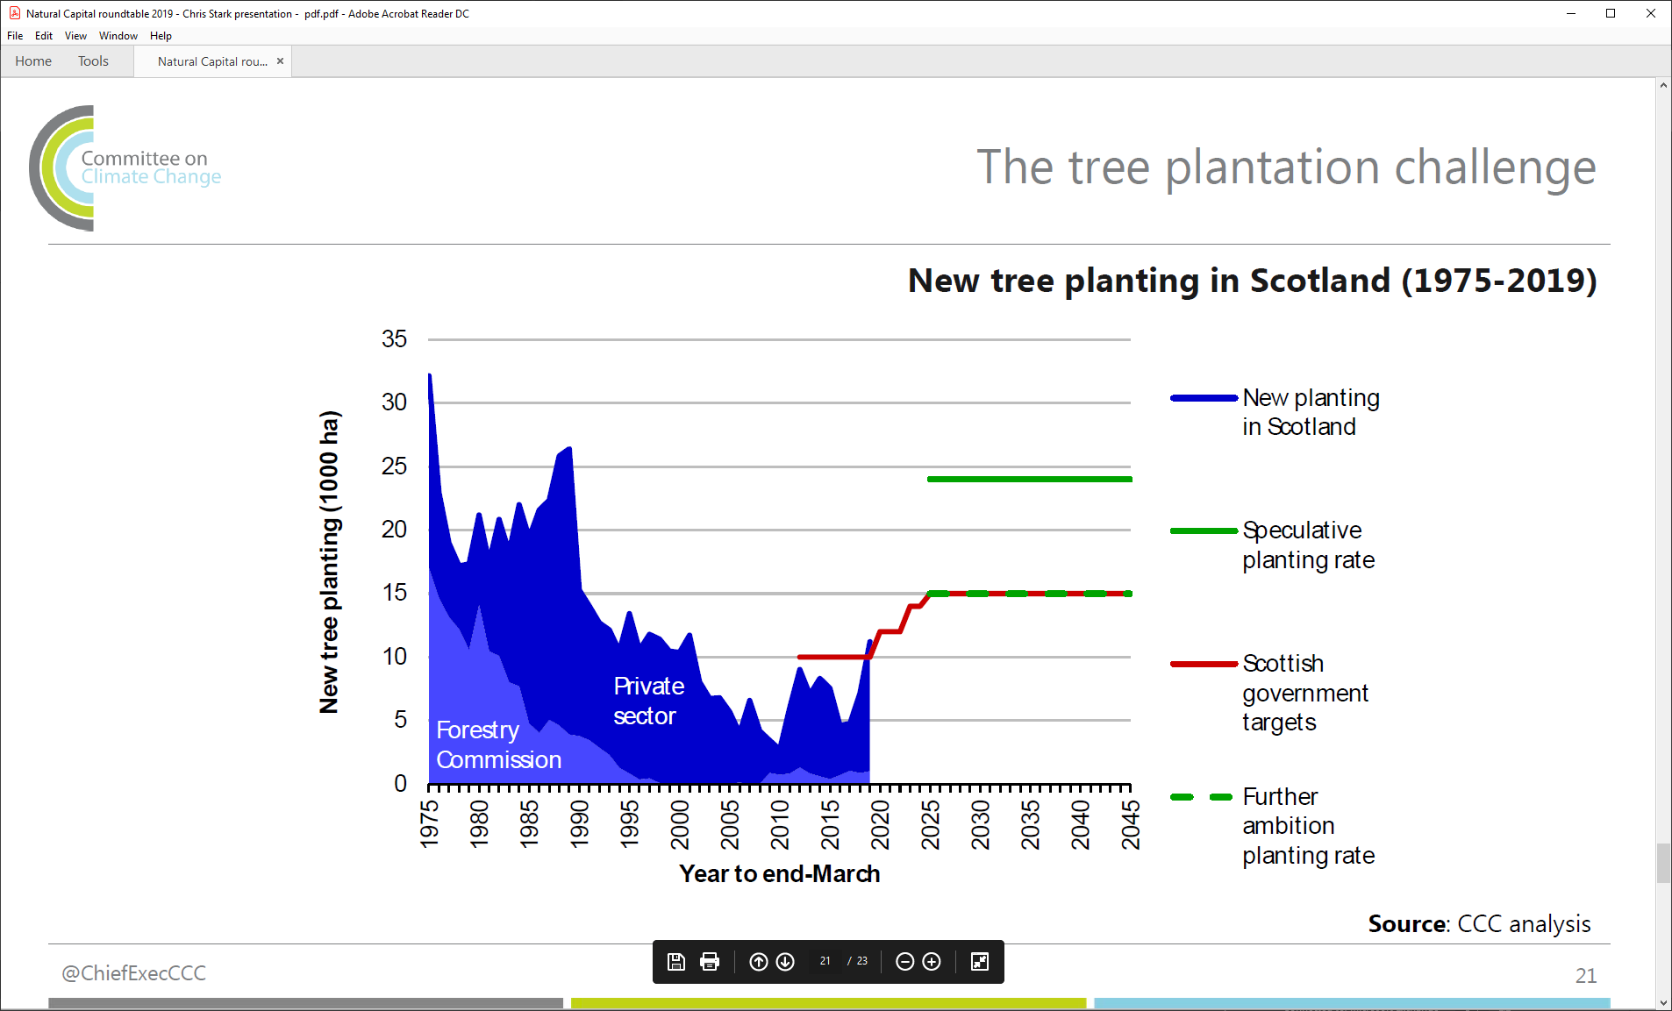
Climate Emergency – a time to act
Notes:
From evidence from ice cores, Carbon dioxide levels have in the last decades doubled what they have been over the last 800,000 years. The last time they were at current levels was 3m years ago before humans lived on the earth and when sea levels were 20m higher. This highlights the problem to be fixed. We’re faced with a choice now as to the action to take if we are to keep within target temperature increases. The cost of cutting emissions is much, much, much less than the cost of adapting. Globally we need to be net zero in emissions of all greenhouse gases by the 2070s. Scotland and the UK have more ambitious targets because we are a mature, well-developed economy.
Emissions from peatlands will be included in the inventory (on which targets are based) by 2024 which will make reductions harder to achieve.
Investing in tree planting should also reflect their value for biodiversity.
Emissions reductions won’t happen by magic. The policies that are made by governments in the next 12 months will determine what happens in the next 30 years, which will matter for the next 1000 years or more.
The UK can’t achieve net zero emissions by 2050 without Scotland achieving net zero by 2045.

Slide 3
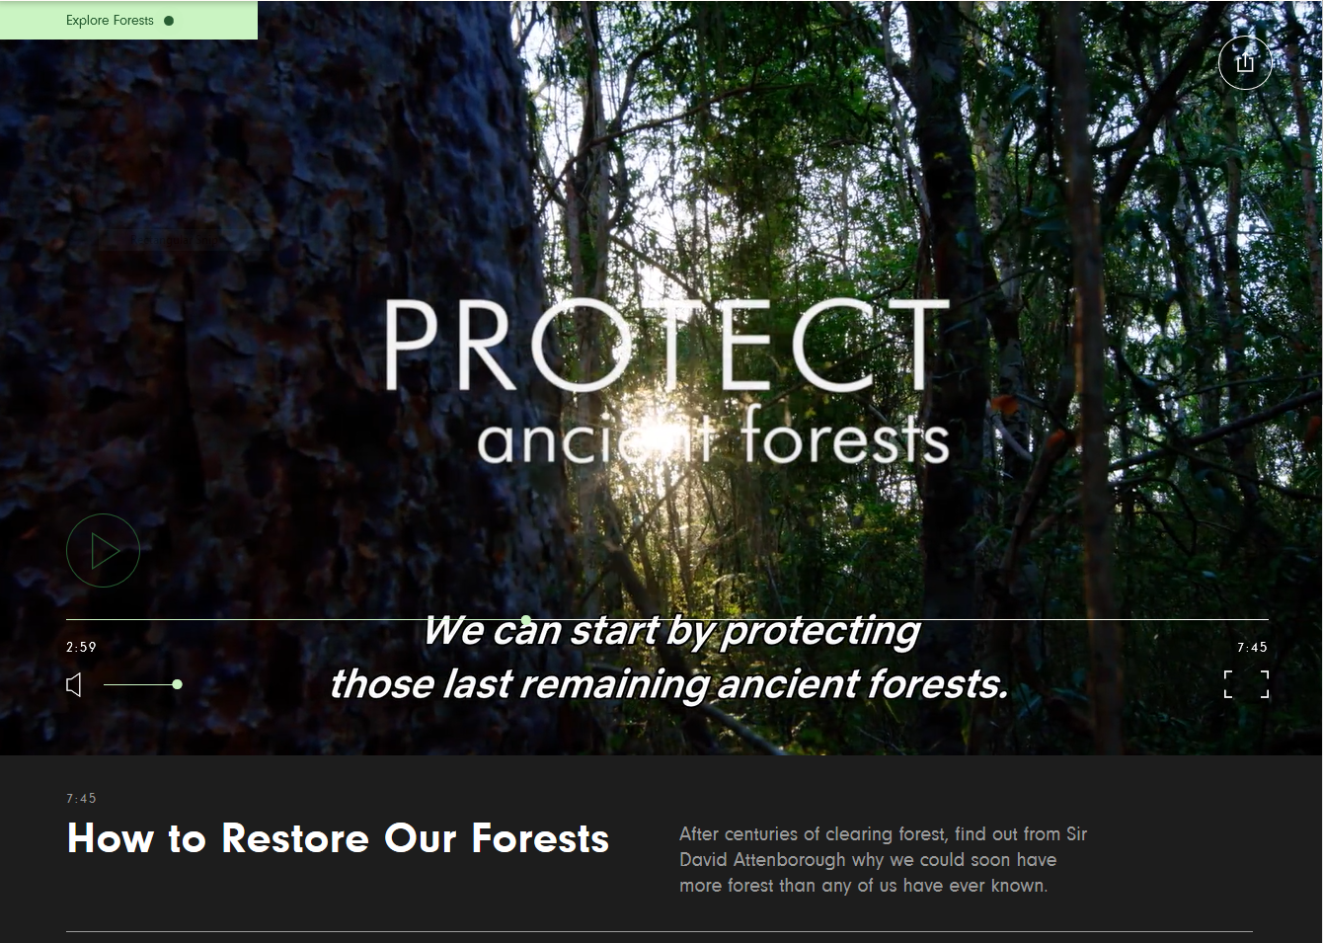
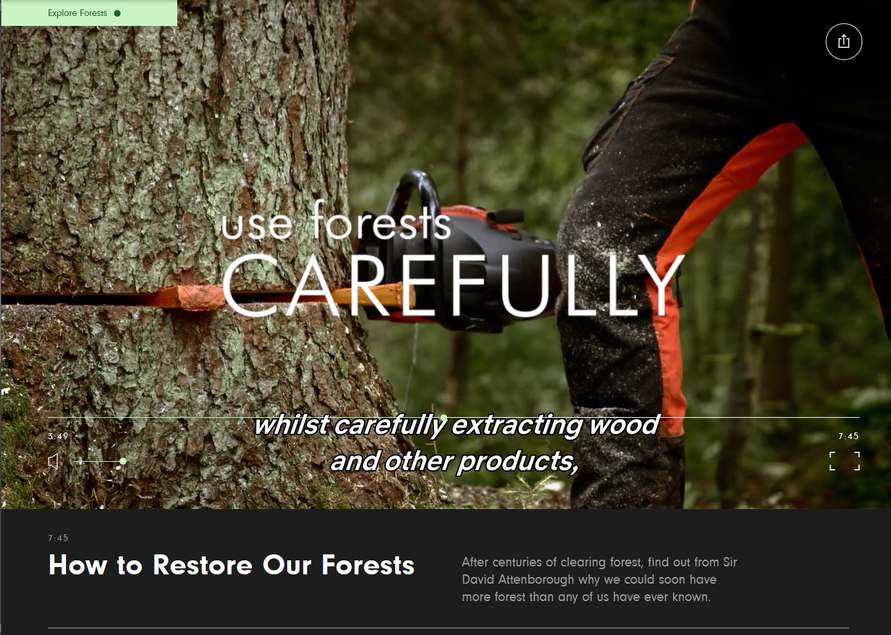
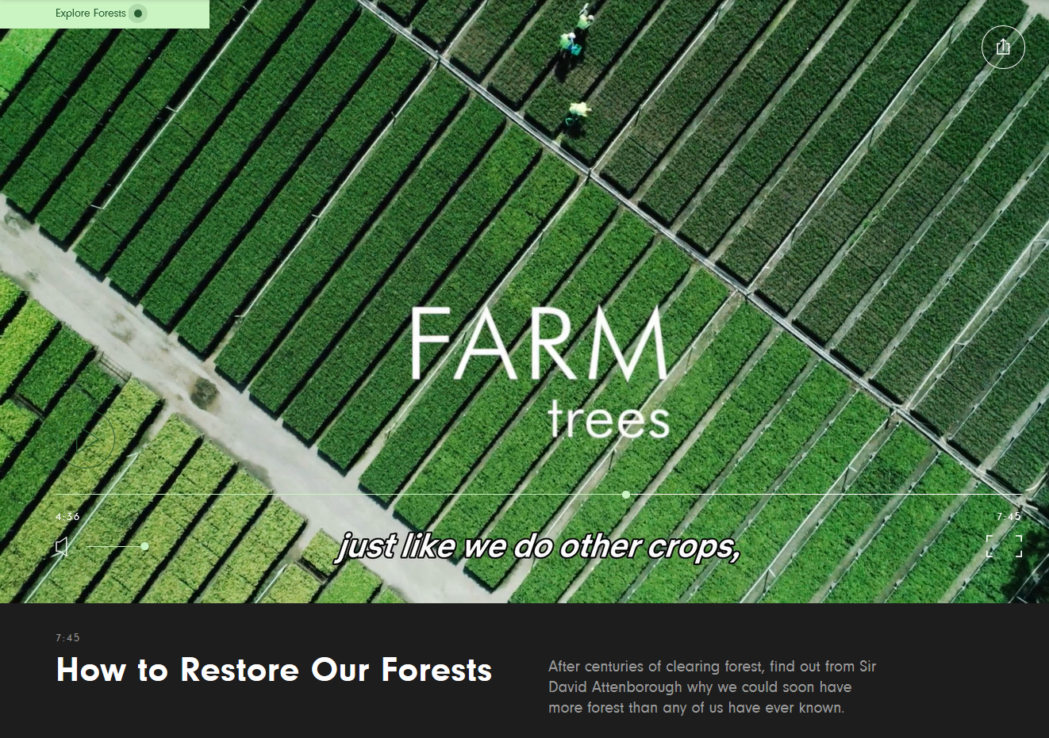
Climate Emergency – a time to act
Notes:
Sustainable Forest Management, as delivered by UKFS compliant forestry, is a legitimate use of our land base in Scotland and land owners are encouraged to come forward with suggested areas of land for planting to enable the Scot Gov targets to be achieved.

Slide 4
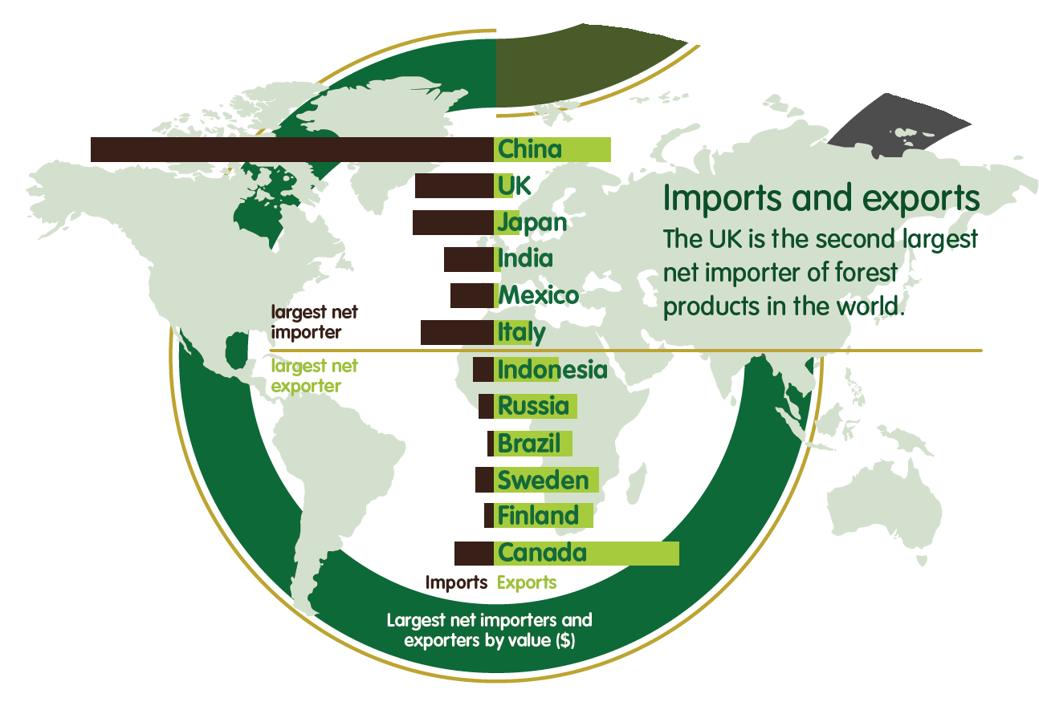
The UK already imports 80% of its wood products and is the second biggest net importer of wood-products in the world, the impact of its offshoring on global forests is a matter of serious responsibility.
Domestic demand set to increase further.
Biodiversity Crisis – a time for change
‘Transformative changes’ needed to restore and protect nature … a fundamental, system-wide reorganisation across technological, economic and social factors, including paradigms, goals and values’ (IPBES 2019).
Notes:
BUT - We will all also have heard about the biodiversity crisis which requires international responses. There is a need for a fundamental …. Values (IPBES 2019). That includes thinking about our international impacts caused by the importing of wood products - If we are to take our biodiversity responsibilities seriously we need to recognise the role we have at home and not continue to offshore our responsibilities to other countries.

Slide 5
Implications for forestry
Business as usual is not an option – measured change is vital to support both climate change mitigation and safeguarding biodiversity.
The internationally recognised Biodiversity value of SFM (all woodland types) should be acknowledged, promoted and developed domestically [as recently acknowledged by SELink: Managing deer for climate, communities and conservation. 2020].
SF are fully committed to achieving the Climate Change planting targets – but there will still a requirement to comply fully with UKFS.
We need to make available more relevant information for land owners and regulators.
Notes:
Where does that place us today ? Going forward for all of us here today business as usual is not a option that can be legitimately defended – change is needed and its needed now.
Firstly - Forests and woodlands have an important contribution towards biodiversity and ecosystem services this needs to be supported outwith the forestry sector and the contribution we make improved further.
Secondly UKFS compliance is still required as we strive to deliver SG targets, which includes other targets such as the native woodland target under SBS (In 2018-19 of 11,210 ha - 4,436 ha was native woodland.
So while we deliver new afforestation UKFS will remain as the minimum compliance requirement for SRDP supported afforestation (and other forestry activities)
Thirdly - we need to make available more relevant information for land owners and regulators so that risks and opportunities are presented equally and considered before decisions are made.

Slide 6
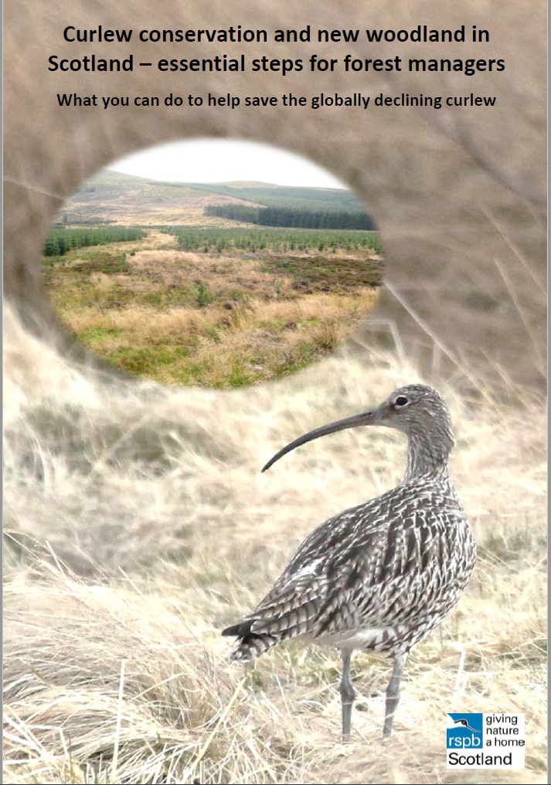
New Guidance – RSPB policy statement
“RSPB supports the expansion of Scotland’s woodlands, especially native species, in locations where the impact on important open ground species and habitats is low. “
‘Expanding our woodland cover is essential, but there is space to accommodate potentially competing biodiversity impacts if a strategic approach is taken.’
‘Seek alternative locations for woodland proposals which allow woodland expansion on habitats which do not threaten curlew’
Notes:
Its good to know that RSPB recognises and supports Scot Gov planting targets, and the guidance we have started to provide to the sector, and we want to work collaboratively with stakeholders to deliver targets.
Their recent policy team document suggests there are areas where ‘right tree in the right place’ can be supported – they suggest a strategic approach is used to identifying suitable areas for expansion .additionally as already identified today alternative locations are not always readily available – and it is the legitimate right of all land owners to decide what and how their land will be used.

Slide 7
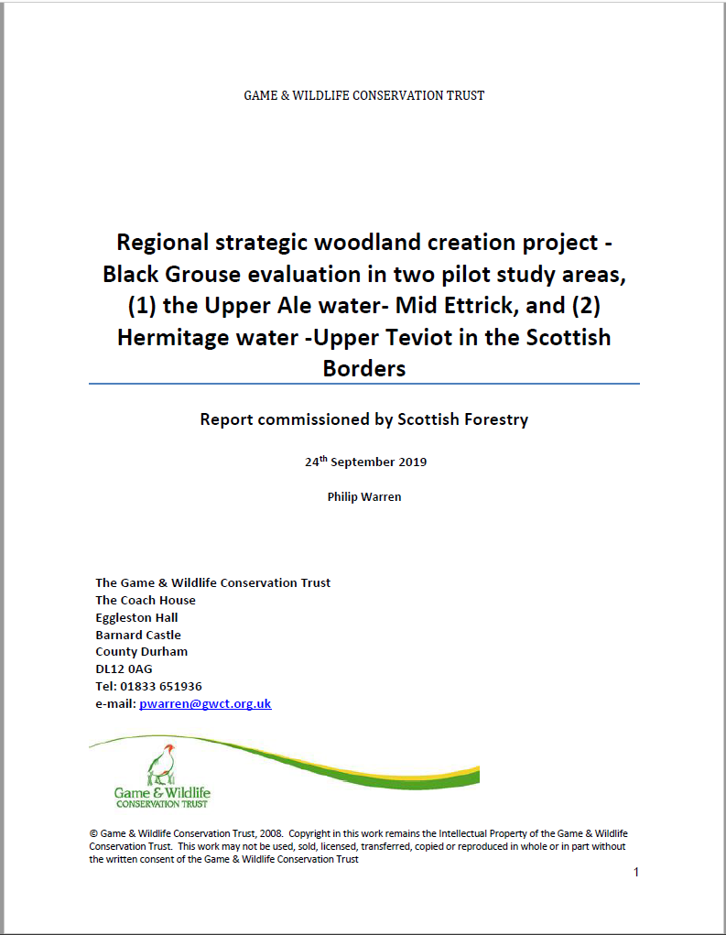
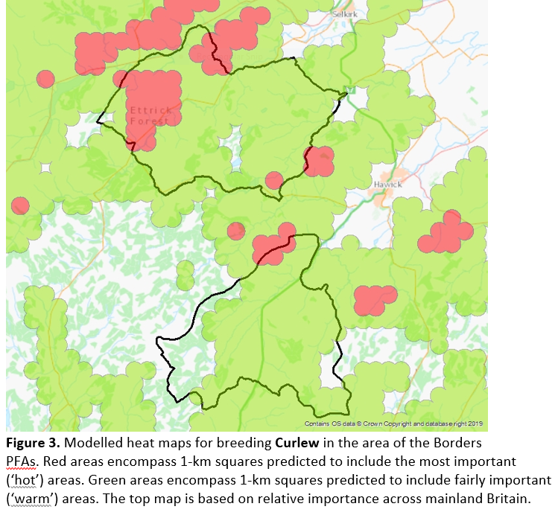
Strategic approach
Collaborative projects : Developing tools to recognise constraints and opportunities for breeding birds associated with forest expansion: Pilot Forest Areas in the Scottish Borders.
John Calladine, Mark Wilson,
BTO Scotland
Notes:
For BG we commissioned work building on Phil Warren’s earlier strategic work on the South Scotland population – to help take a landscape / strategic response using multiple lines of evidence. We intend using this evidence to help landowners understand the importance of some areas for BG, but also to identify strategic areas where afforestation can be supported and the route to approval made easier.
For waders a strategic approach was initiated with commissioned work in 2018 with joint work to model important ground nesting wader areas or ‘hotspots’ these sensitivity maps can hopefully be used to inform landowners well in advance of their schemes being designed – so that an informed approach to the woodland design can be taken early – so that the most valuable areas can be protected, and less important areas given stronger support for expansion. This approach still requires consensus/agreement on what constitutes an important area – and agreement on what an appropriate response would be in each case. These are not constraint maps that can be used to dictate where or where not forestry will be supported – but help provide landowners with earlier indications of the relative importance of land they own or manage. Work is need to translate that into support for the forest sector while protecting existing important breeding populations.

Slide 8
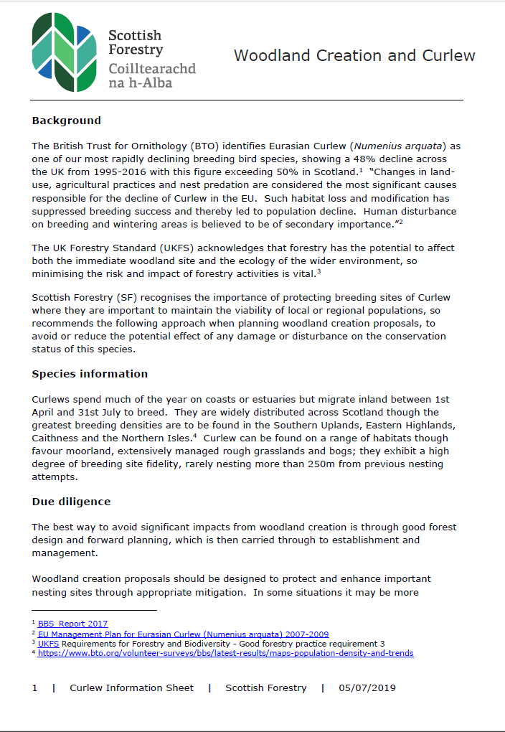
Existing Guidance – Scottish Forestry
‘The best way to avoid significant impacts from woodland creation is through good forest design and forward planning, which is then carried through to establishment and management. ‘
‘It is important to also undertake an overall assessment of the biodiversity benefits that the woodland creation proposal will provide and include this in your application, as this will need to be considered alongside the impact on [species].
When considering whether or not to approve a planting proposal Scottish Forestry will carefully consider the potential impact on curlew populations together with other environmental benefits before reaching a decision. Where there is an unmitigated impact on a significant local breeding population or area of breeding habitat, it is unlikely that Scottish Forestry would approve a planting proposal.
Notes:
Additionally we have developed more detailed guidance specifically for curlew because the existing guidance for protected bird species was inappropriate – by providing this information early we hope more appropriate schemes come forward, or have considered and incorporated appropriate mitigation into design plans. Early discussion with specialists is essential in important areas. We would anticipate stakeholder groups – such as RSPB, BCS etc – help identify suitable areas for woodland expansion, and help landowners understand the positive and negative aspects of any proposal.

Slide 9

Thank you

