Slide 1
The challenge of forest design for sensitive species - a case study
Jenny Mulgrew
JDM Woodland Management Ltd
jdmwoodlandmanagement@hotmail.com
07960 034732
Notes:
JDM is a young company deals with predominantly medium-large sized WC schemes across Scotland, predominantly focusing on more native designs.
Jenny, ****
John – Forester with over 20 years experience, deals with forest design, operational management
Case study focuses on one site and black grouse
Focus mainly on BK but will mention challenges for other species / habitats
Speak about why WC site are selected, comms between landowner and us
WC scheme at Hopecarton Glen
SBC Pilot and future of WC vs land availability vs sensitive species

Slide 2
Woodland creation process
Brief from landowner
Identification of land & suitability
JDM woodland design
Consideration/mitigation for black grouse and other sensitive species
Notes:
Talk outline

Slide 3
Extent of farm approx. 1600 ha ~90% covered by SSSI/NSA
Hopecarton Farm, Drumelzier, Scottish Borders
National Scenic Area (blue)
Prime quality agricultural land (brown)
Key environmental designations, SAC (orange), SPA (purple), and SSSI (yellow)
Existing woodland (grey)

Slide 4
Landowner objectives
Farm diversification
Productive mixed woodland, possibly including SS - grows well at Stanhope
Approx. 150 ha
Must be able to gather sheep on lower track
Limitations - Tweedsmuir Hills SSSI and NSA, also River Tweed SAC/SSSI, SLA

Slide 5
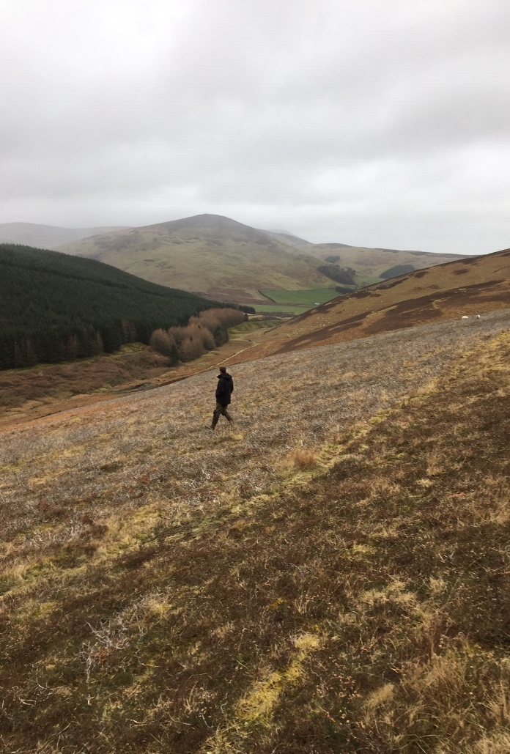
Site visit
Gain an understanding of the site:
Aspect
Topography
Vegetation
Soils
Access issues
Grazers / browsers
Present biodiversity
Confirmed it was a good site for woodland creation.
Burnt/grazed heather at approx. 350 m elevation (Feb 2019).
Notes:
How attractive habitat for birds, signs (such as raptor feathers/pellets, otter spraint, whinchats, etc).

Slide 6
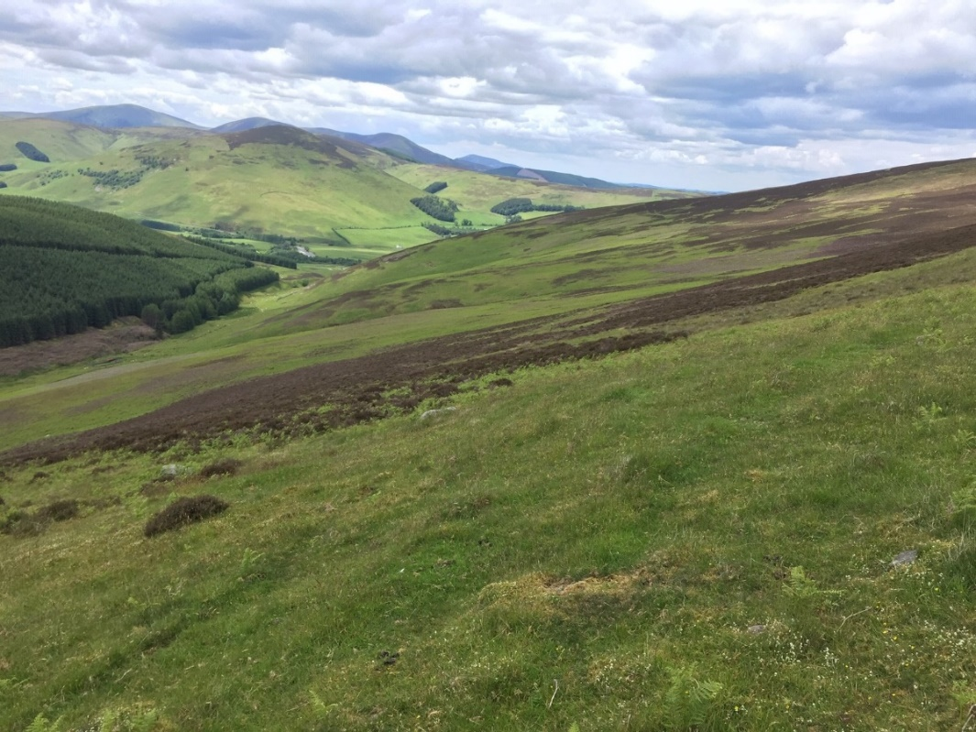
Initial steps towards woodland creation
Landowner informed of suitability for a range of tree species.
Due diligence - >30 data sources incl. Woodland Strategy
SF Woodland Officer requested:
BBS
Black grouse survey
Archaeology survey
Soil assessment
Landscape assessment
Phase 1/NVC
WC Advice Note, SBC March 2019:
PEA Report
Approx. 420 m elevation, heather with bracken on lower ground (June 2019).

Slide 7
Scottish Borders Council – LUS Pilot Maps
Stock of Natural Capital

Slide 8
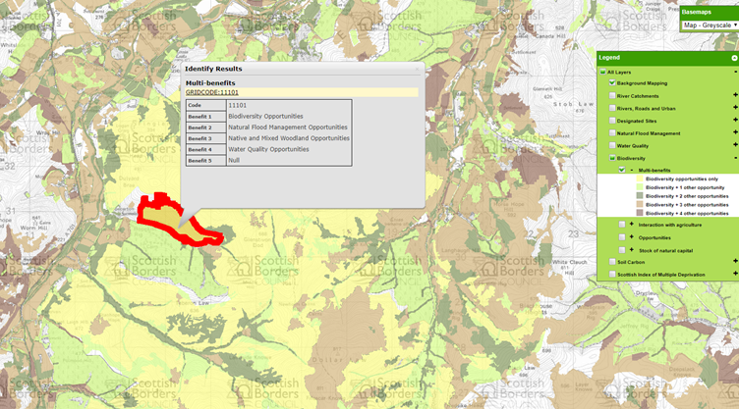
Scottish Borders Council – LUS Pilot Maps
Opportunities for Multiple-benefits

Slide 9
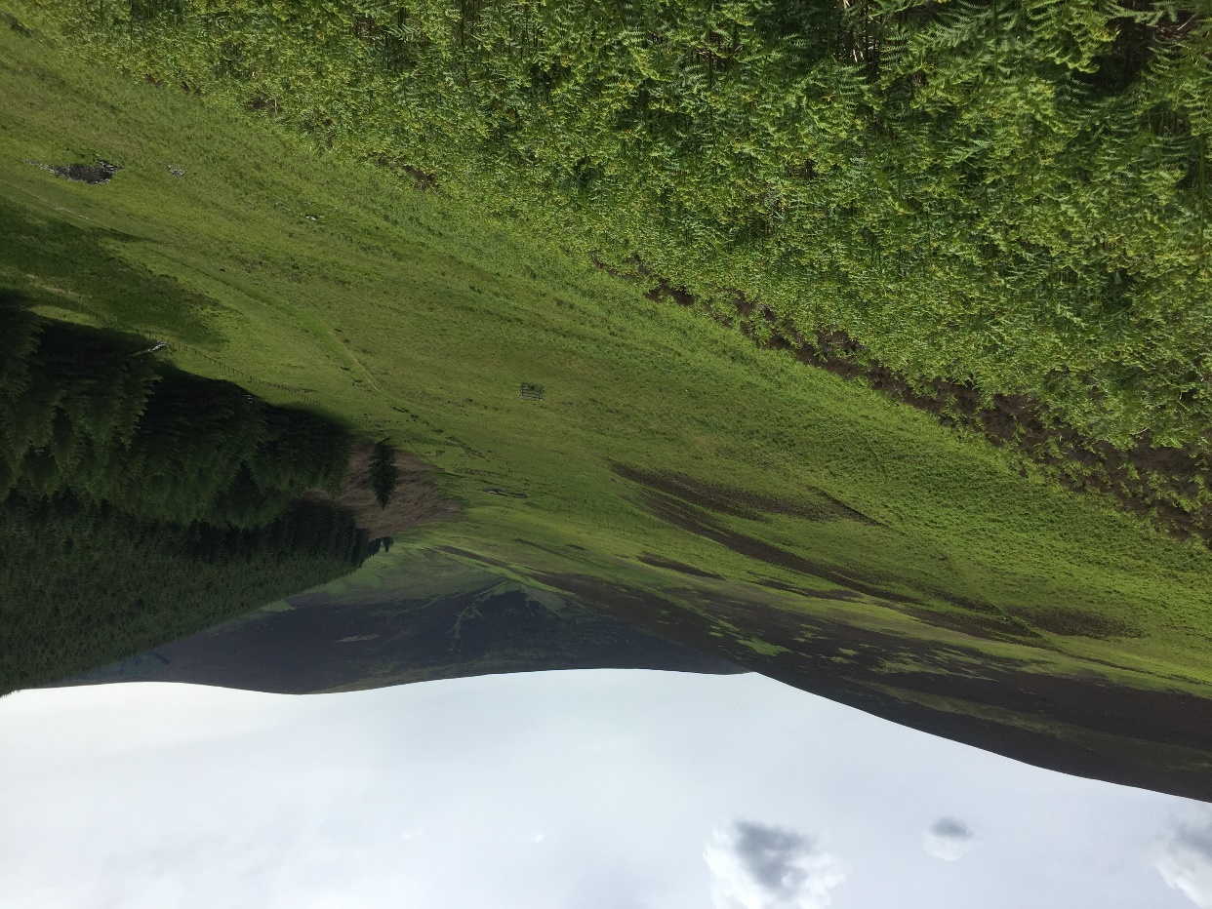
Black grouse
Tweedsmuir Hills ‘core area’ supporting 39% of all males and 38% of all leks in southern Scotland
Distribution of black grouse leks between 2011-15 in relation to habitat. Extract from Warren (2016).
Leks on lower ground but not recently
Black grouse occasionally seen
Ongoing predator control

Slide 10
Concept Map 1 – before surveys
WOODLAND DESIGN
Based upon landowner objectives, site ecology, and what can be grown.
Design determined by topography, vegetation & soils.
Follows traditional silvicultural practices commonly used in Scandinavia & c. Europe.
We aim to provide different options aside from SS, best suited to the site, provide a good return.
Prevailing wind
Design principle
SP/SBI ASP/SBI
NS SBI
ASP/SBI/FM
BE NBL
Steep ground
Notes:
Concept design, no surveys done. Sent to stakeholders for comment – invaluable.
Steep ground left unplanted
150 ha -> 100 ha
Suitable for conifers & productive broadleaves
SP/birch mix- Prefer drier ground. Predominantly on convex knolls, heather dominant areas (grow with heather rather than spray the heather).
NS – prefer wetter ground with more flushing. Less heather, more grass. Predominantly on concave ground, can withstand frost hollows, but likes nutrient flushing.
Productive blv mix - Birch/aspen/FM planted in bracken. These like predominantly concave ground with added shelter.
Silver birch - slightly convex ground, as likes heather and can deal with exposure.
Beech – lower ground, lot of flushing, free draining, deeper more fertile soils, good. Elevation too high for oak.
Aspen / birch - concave ground, can also take flushing, can tolerate exposure on good deep soils.
Mixes add autumn colour and self-thin in the appropriate areas – when you come in to thin the woodland the most suitable species will remain.
NBL (low density) placed to reduce wind speed into the productive broadleaves so they don’t blow as they mature AND diversity on the edges
Landscape terms – no hard edges, key flushes remain open to the moorland edge.
Heather topped to enable good planting position, enviro-mounder & excavator hinge mounding (rather than plough),

Slide 11
WOODLAND MANAGEMENT
Low Intensity Silvicultural System (CCF) AND clearfell.
CCF not generally designed into NWC in British forestry.
LISS benefit overall biodiversity by increasing woodland species and structural diversity.
Conifer - Clearfell system due to exposure and risk of windblow.
Track accesses 5-6 smaller blocks that can be clearfelled one (or more) at a time.
BLV - CCF thinned to produce quality hardwoods.
Thinnings could be included when machinery there to clearfell.
Supply firewood, niche markets, leading eventually to quality hardwood markets.
Farm income generated from initial grant, followed by revenue from thinnings & clearfells.
Notes:
This is our WC 15th site in Scotland, including Highlands, west coast, s. Scotland and c. Scotland and all are different but all follow these silvicultural principles of the right tree in the right place. The majority include a proportion of CCF and none are designed to be entirely clearfelled.

Slide 12
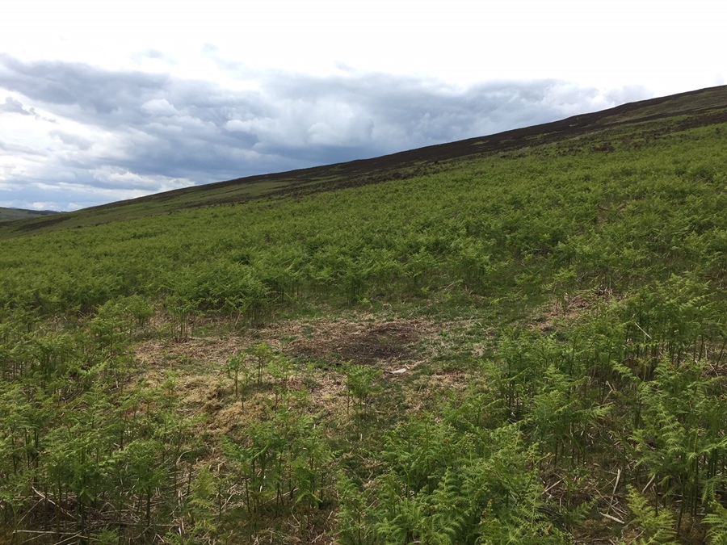
Survey findings – black grouse
1 single lekking male - in heather/bracken at 380 m
Tweedsmuir Hills 41% of known sites occupied by single males (Warren 2016)
Likely to be ‘last man standing’ rather than range expansion
Meta population is not usually considered – hard to assess cumulative impact
‘Implement conservation measures to increase breeding success and overwinter survival to consolidate populations and provide recruits to recolonise neighbouring areas’
Lack of native woodland in this area

Slide 13
Mitigation for black grouse
Guidance lacking for:
Around leks:
Buffer for tree planting? RSPB 1993 - 50m.
Same for low density NBL?
Less risk if there is predator control?
Adjust for elevation?
Connectivity to moorland:
Width?
Depends who you deal with
We are all doing something different, relevant research?
Fencing:
Better to fence in or out? Further fencing cuts contours
Stock fence not an option
Chance of success?
Individual lek specific mitigation has poor record of success
Will males respond to hens?
Benefits likely at a population level?

Slide 14
Attractive Merlin nesting habitat
Flushes, GWDTEs
Reptiles
Northern Brown Argus food plants
Sensitive species & habitats
Whinchat
Hairy stonecrop
Small Pearl-bordered Fritillary colonies
The Avenza app has revolutionized site planning & management
Lesser tussock sedge in valley mire
Notes:
Reuben – really good Phase 1/NVC by local ecologist – flushes, small pearl bordered fritillary colonies, foodplants of NBA, reptiles, hairy stonecrop
BBS – whinchat
Track location

Slide 15
L/owner agreed to mitigation, in line with conservation objectives.
Lek buffer 70 – 100 m.
Looked at re-allocation to W & E edges but not possible.
Design & black grouse
Flushes buffered & connected to moorland edge.
Heather/blaeberry retained.
NS will lose understory.
NBL including birches, willows, blackthorn, hawthorn, rowan, hazel, alder, juniper.
Offers a lot in terms of overwinter survival (Warren 2016).
Final design – Aug 2019

Slide 16
Multiple benefits
Carbon sequestration
Net gain in biodiversity
Increased resilience to climate change
Improved water quality, NFM to SAC/SSSI
Improved visual diversity & autumn colours on edge of the NSA
Links existing native woodland fragments
Improved public access
Allows sheep gathering – surrounding agricultural land use retained
Generates income in short, medium and long-term
Allows next generation to access diverse, attractive woodlands

Slide 17
Summary
87 ha tree cover (5% of landholding).
Provides landowners with more options, offering an alternative to predominantly single-species woodlands and clearfelling.
Can be scaled up, but unlikely to suit the present model for large-scale forestry investors / forest management companies supplying timber mills.
Far more intensive (management time & more expensive to deliver), still yields better initial returns than most Sitka spruce options due to a better grant rate.
Better initial return often suits those wanting to clear farm debts or to invest in their more productive land.

Slide 18
Jenny Mulgrew, John Mulgrew
JDM Woodland Management Ltd
jdmwoodlandmanagement@hotmail.com
07960 034732

