Slide 1
Borders Climate Hub
What do we want to achieve?
Net-zero and a climate resilient Borders through community actions and activities
How can we achieve this?
Through establishing a Vision for the future that we aim to define and achieve through a self-organising, fully inclusive, adaptive network to support communities in their efforts to reach net-zero and create a resilient Scottish Borders
What’s the “hub”’s role in this?
To enable and facilitate the emergence of this self-organising network/system by:
strengthening the capacity of existing individuals, groups and organisations to support communities
identifying gaps and helping to fill them
facilitating the interconnections between those agents
The word “hub” is used by ScotGov but this is felt to misrepresent our ambition which is to be a Borders wide enterprise, focused on actions and activities to tackle climate change across the whole region, the name Borders Climate Action Network has been agreed as a working title. “Hub” implies something centralized and controlling. We aim to do things differently here developing a model of working that provides autonomy for groups and individuals whilst working towards an agreed, shared, emergent, collaborative and ambitious vision for a resilient future.

Slide 2
Borders Climate Action Network
There are lots of great projects happening across the Borders. To uncover and map these activities, a Borders Green Summit was held in March and SCCAN visioning sessions were held in 2022/23
These events
Highlighted key themes to be addressed if the Scottish Borders are to have a just transition to net zero
Created energy and ideas and demonstrated the need for further work
Started to build a strong network of groups including charities, CICs, statutory bodies and individuals
Recognised that embracing communities and other organisations not traditionally considered “Green” is key to long term success in tackling climate change
Proposed the creation of a “hub”, in-line with the Scottish Government initiative to support community climate action (https://www.gov.scot/policies/climate-change/climate-challenge-fund/)
The summit and visioning sessions resulted in the formation of a “Next Steps” steering group, with individuals volunteering to take things forward

Slide 3
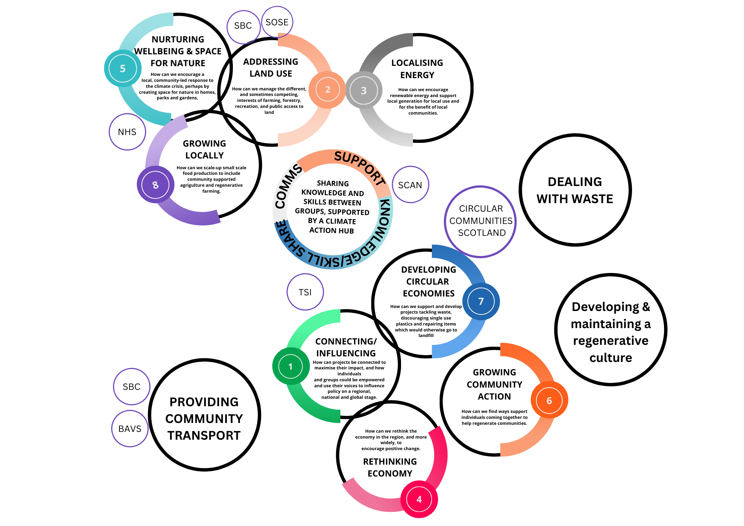
Borders Climate Action Network
The 8 Themes and how a hub fits into the Borders climate action landscape

Slide 4
Borders Climate Action Network
At the beginning of July, the Steering Group made an application to the Scottish Government, on behalf of the network, to establish a Climate Hub in the Scottish Borders.
The funds will be used to formulate the vision and design the “hub” (the way the network will operate to achieve the vision) and continue to build, strengthen and extend the network.
After developing a powerful feeling of collaboration at the Green Summit there is a strong desire across the network to do things differently. We want to challenge the norm of groups competing for money, and challenge the notion that funding, and activity is controlled centrally.
The Steering Group will support this process until a more permanent, agreed structure for the Climate “Hub” has been determined by the network.

Slide 5
Planning Phase
July to September
Design Phase
October to March
Delivery Phase
April 2024 & onwards
Borders Climate Action Network
Progress so far and future landmarks
Interim Steering Group
Steering Group & Network Consultations
Network Steering and Management Group
Application Submitted by Southern Uplands Partnership on behalf of the network
Potential Scottish Government funding for the Climate “Hub” Design Phase
Potential Scottish Government funding
for the creation of a Scottish Borders Climate “Hub“

Slide 6
Borders Climate Action Network
How a Hub can support Climate Change Action
Sharing knowledge and skills between groups, supported by a climate action hub
Connecting & influencing
Promoting community transport and active travel
Growing food locally
Growing community action
Creating and maintaining A Greener Borders
Organising to maintain a Hub and to influence policy
Nurturing wellbeing and space for nature
Influencing the broader picture
Addressing land use
Rethinking economy
Localising energy
Dealing with waste
Developing circular economies
These items provide an example based on the outcomes from the Green Summit. This will be re-done with wider participation in the design phase.

Slide 7
Borders Climate Action Network
Next Steps
Once we receive the money, the task of a creating a shared vision and designing the Climate “Hub” to achieve that vision that meets the needs of individuals, groups and organisations across the Scottish Borders will begin.
While the events that have already taken place have highlighted areas to address, the challenge of tackling climate change is ever changing, and new opportunities and challenges will arise.
There is a strong desire in the Scottish Borders to do things differently, and to work collaboratively and inclusively to create an effective network to support our vision for a just transition to Net Zero.
Over the coming months there will be opportunities to be involved and to help create the vision, shape the design of the “Hub” and influence how we meet the challenge of our changing climate.
Please join the mailing list by sending your details to piptabor@sup.org.uk
Please circulate this information to anyone in your network, individuals, groups and organisations, who you think would like to be involved (we don’t currently have a comprehensive list so we are relying on you all to do this).

Slide 8
Borders Climate Action Network
Interim Steering Group
Pip Tabor – Southern Upland Partnership
Yvan Biot – Greener Melrose
Louise Cox – Scottish Borders Council
Rachel Hardie – Greener Berwickshire
Catherine Francis – South of Scotland Enterprise
Marianne Broadgate – Greener Melrose
Lesley Morrison – Greener Peebles
Oliver, Penny – Borders NHS
Karen Birch – Abundant Borders
Juliana Amaral – Borders Community Action
Angela MacKellar – Sustainable Selkirk
Alice Fisher – Sea the Change
The Steering Group are volunteers and happy to answer any questions you may have

